Slide 1



NASA SPACE APPS CHALLENGE 2017
CSA Challenge #1:
Be a part of Canada’s legacy in space

Slide 2
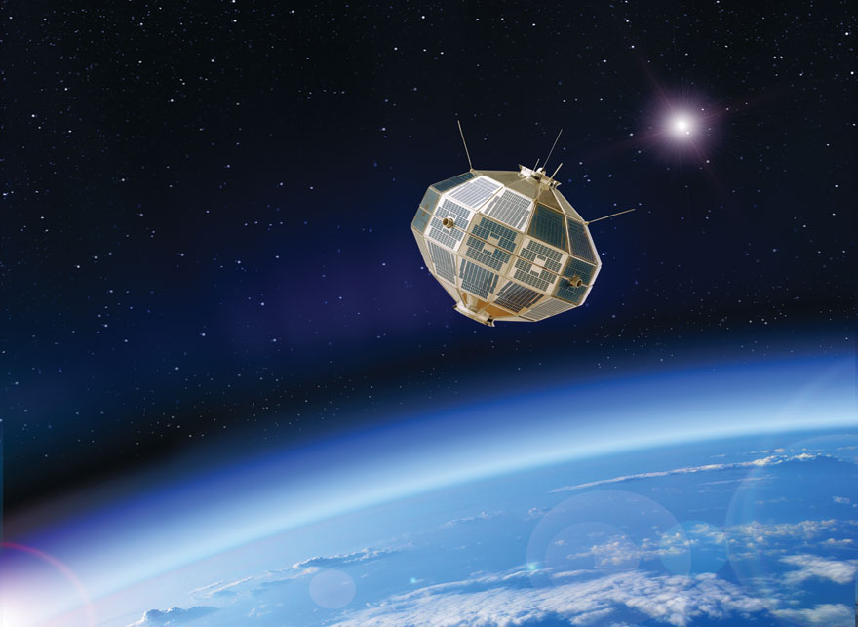
Alouette I
Canada’s First Satellite
Launched in 1962
Data is on 35 mm film rolls and very hard to sort
Acquired information of ionic sphere
Published digital images April 20, 2017
Notes:
Back in 1962, Canada’s first satellite, Alouette-I has been launched into space. It started collecting valuable data on our ionosphere, and sent it to us in a form of 35mm film ionogram images.

Slide 3
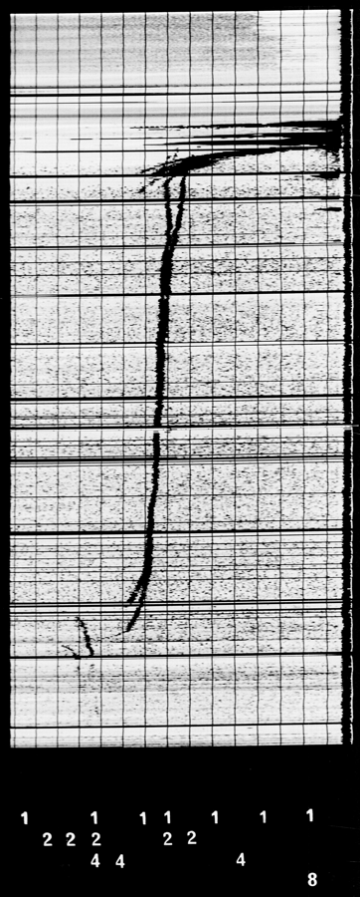
Ionograph Sample
Notes:
The problem, however, is that the valuable data contained in these millions of images gathered for a decade is extremely challenging to decipher, sort and manage for scientists to use. Almost 55 years since the launch, the ionograms has been finally digitalized. So our solution for this problem is to build a tool to collect metadata from the images and organize it in a way that is searchable and meaningful for the data users and scientists.

Slide 4
Goal of the Project and Impact of the Data
Tool will collect metadata from the images and organize it in a way that is searchable and meaningful for the data users and scientists.
Understand how the ionosphere can affect radio propagation signals
Do properties (density or size) of the ionosphere depend on geographical location, season, and time of day?
Notes:
The purpose of this data set?
These historically valuable ionograms contain detailed information about the layers of the ionosphere. It could potentially assist scientists in understanding why there are subtle variations in signals transmitted by sophisticated radio propagation systems such as Global Navigation Satellite Systems (GNSS) and telecommunication satellites.

Slide 5
Parsing the metadata in the Alouette Ionograms
Raw files digitized from 35mm film
Metadata is derived from the position of the dots
Date (year, month, day) and time (hour, minute, second)
Satellite number (Alouette 1)
Station ID
Impediment: The placement of the dots or numbers are not consistent between images or within the same image
Notes:
Parsing the metadata in Allouette pictures
Allouette data is recorded on 35mm film. The data is a picture, the metadata is either dots or numbers
whose meaning is derived from their position on the image.
Both of them have day of year, hour, minute, second, and ground station id. The dot form has a one digit station id.
The number form also includes satellite number, year number (one digit) and a 2 digit station id.

Slide 6
Parsing the metadata in the Alouette Ionograms
Scan the image and find the dot centers
Allowed for an anchor point to compute a set of rectangles containing all of the other data points
Compute the value of each dot by identifying which rectangle it resided in
The value of each digit is computed by summing the value of the dots in each position
Notes:
We attacked the dots problem by scanning the the image and finding the dot centres. We also took advantage of
(what we believe to be) the fact that all the dot images come from ground station one. This gave us an anchor point
to compute a set of rectangles which would contain all the other possible data points. We then computed the value
of each dot by identifying which rectangle it was in.
We did not succeed in analysing digital data.
The value of each digit is computed by summing the value of the dots in each position.
One thing we have learned is that implementing the accurately requires analysis and tweaking using real data. Given
the data volume this means that process must occur in the data centre that holds the data.

Slide 7
Front End Development
Sub Team 1: interacting with database using PHP
Sub Team 2: designers produce wireframes
Website
Landing page
Results page
Individual graph and specifications page
Process
Create overall look
Functionality of each page
Integration with other components (database, raw inputs, etc.)
Notes:
In front-end, we are incharge of the visual interface of the website. Our team is divided into 2 sub teams, one that is working on interacting with the database using php, and one that is working
with the design team to reproduce the provided wireframes. Our website is consisted of 3 main pages, the landing page, result and a page with the individual graph and specifications. The process
starts off with first creating the overall look of the page, before working on the interworkings of each page, like buttons and forms, before finally working on the interworkings of all pages like
how and when we would interact with the database, what would each page need and what would it need to pass, as well as formatting the raw input into something usable for the page.

Slide 8

DEMO TIME

Slide 9
THANKS!
Any questions?

Slide 10
CREDITS
Ali Karamali
Amy Yi
Erin Hong
Frederic Pun
Huanning Wang
Jim Rootham
Karlille John
Michelle Villar
Mohammad Ismail
Patrick Ocampo
Prashant Patel
Sameed Sohani

